Slide 1

English VI
UNIT 2

Slide 2

I am getting used to sleeping early.
I am used to sleeping early.

Slide 3
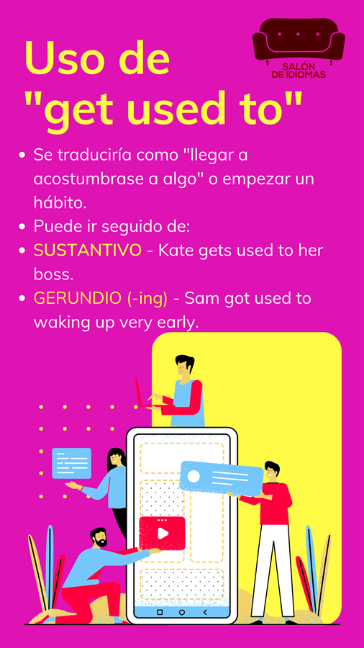
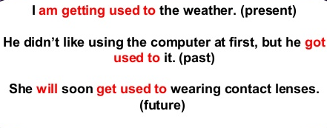
Subject
Get Used to
Verb in gerund
COMPLEMENT
noun

Slide 4
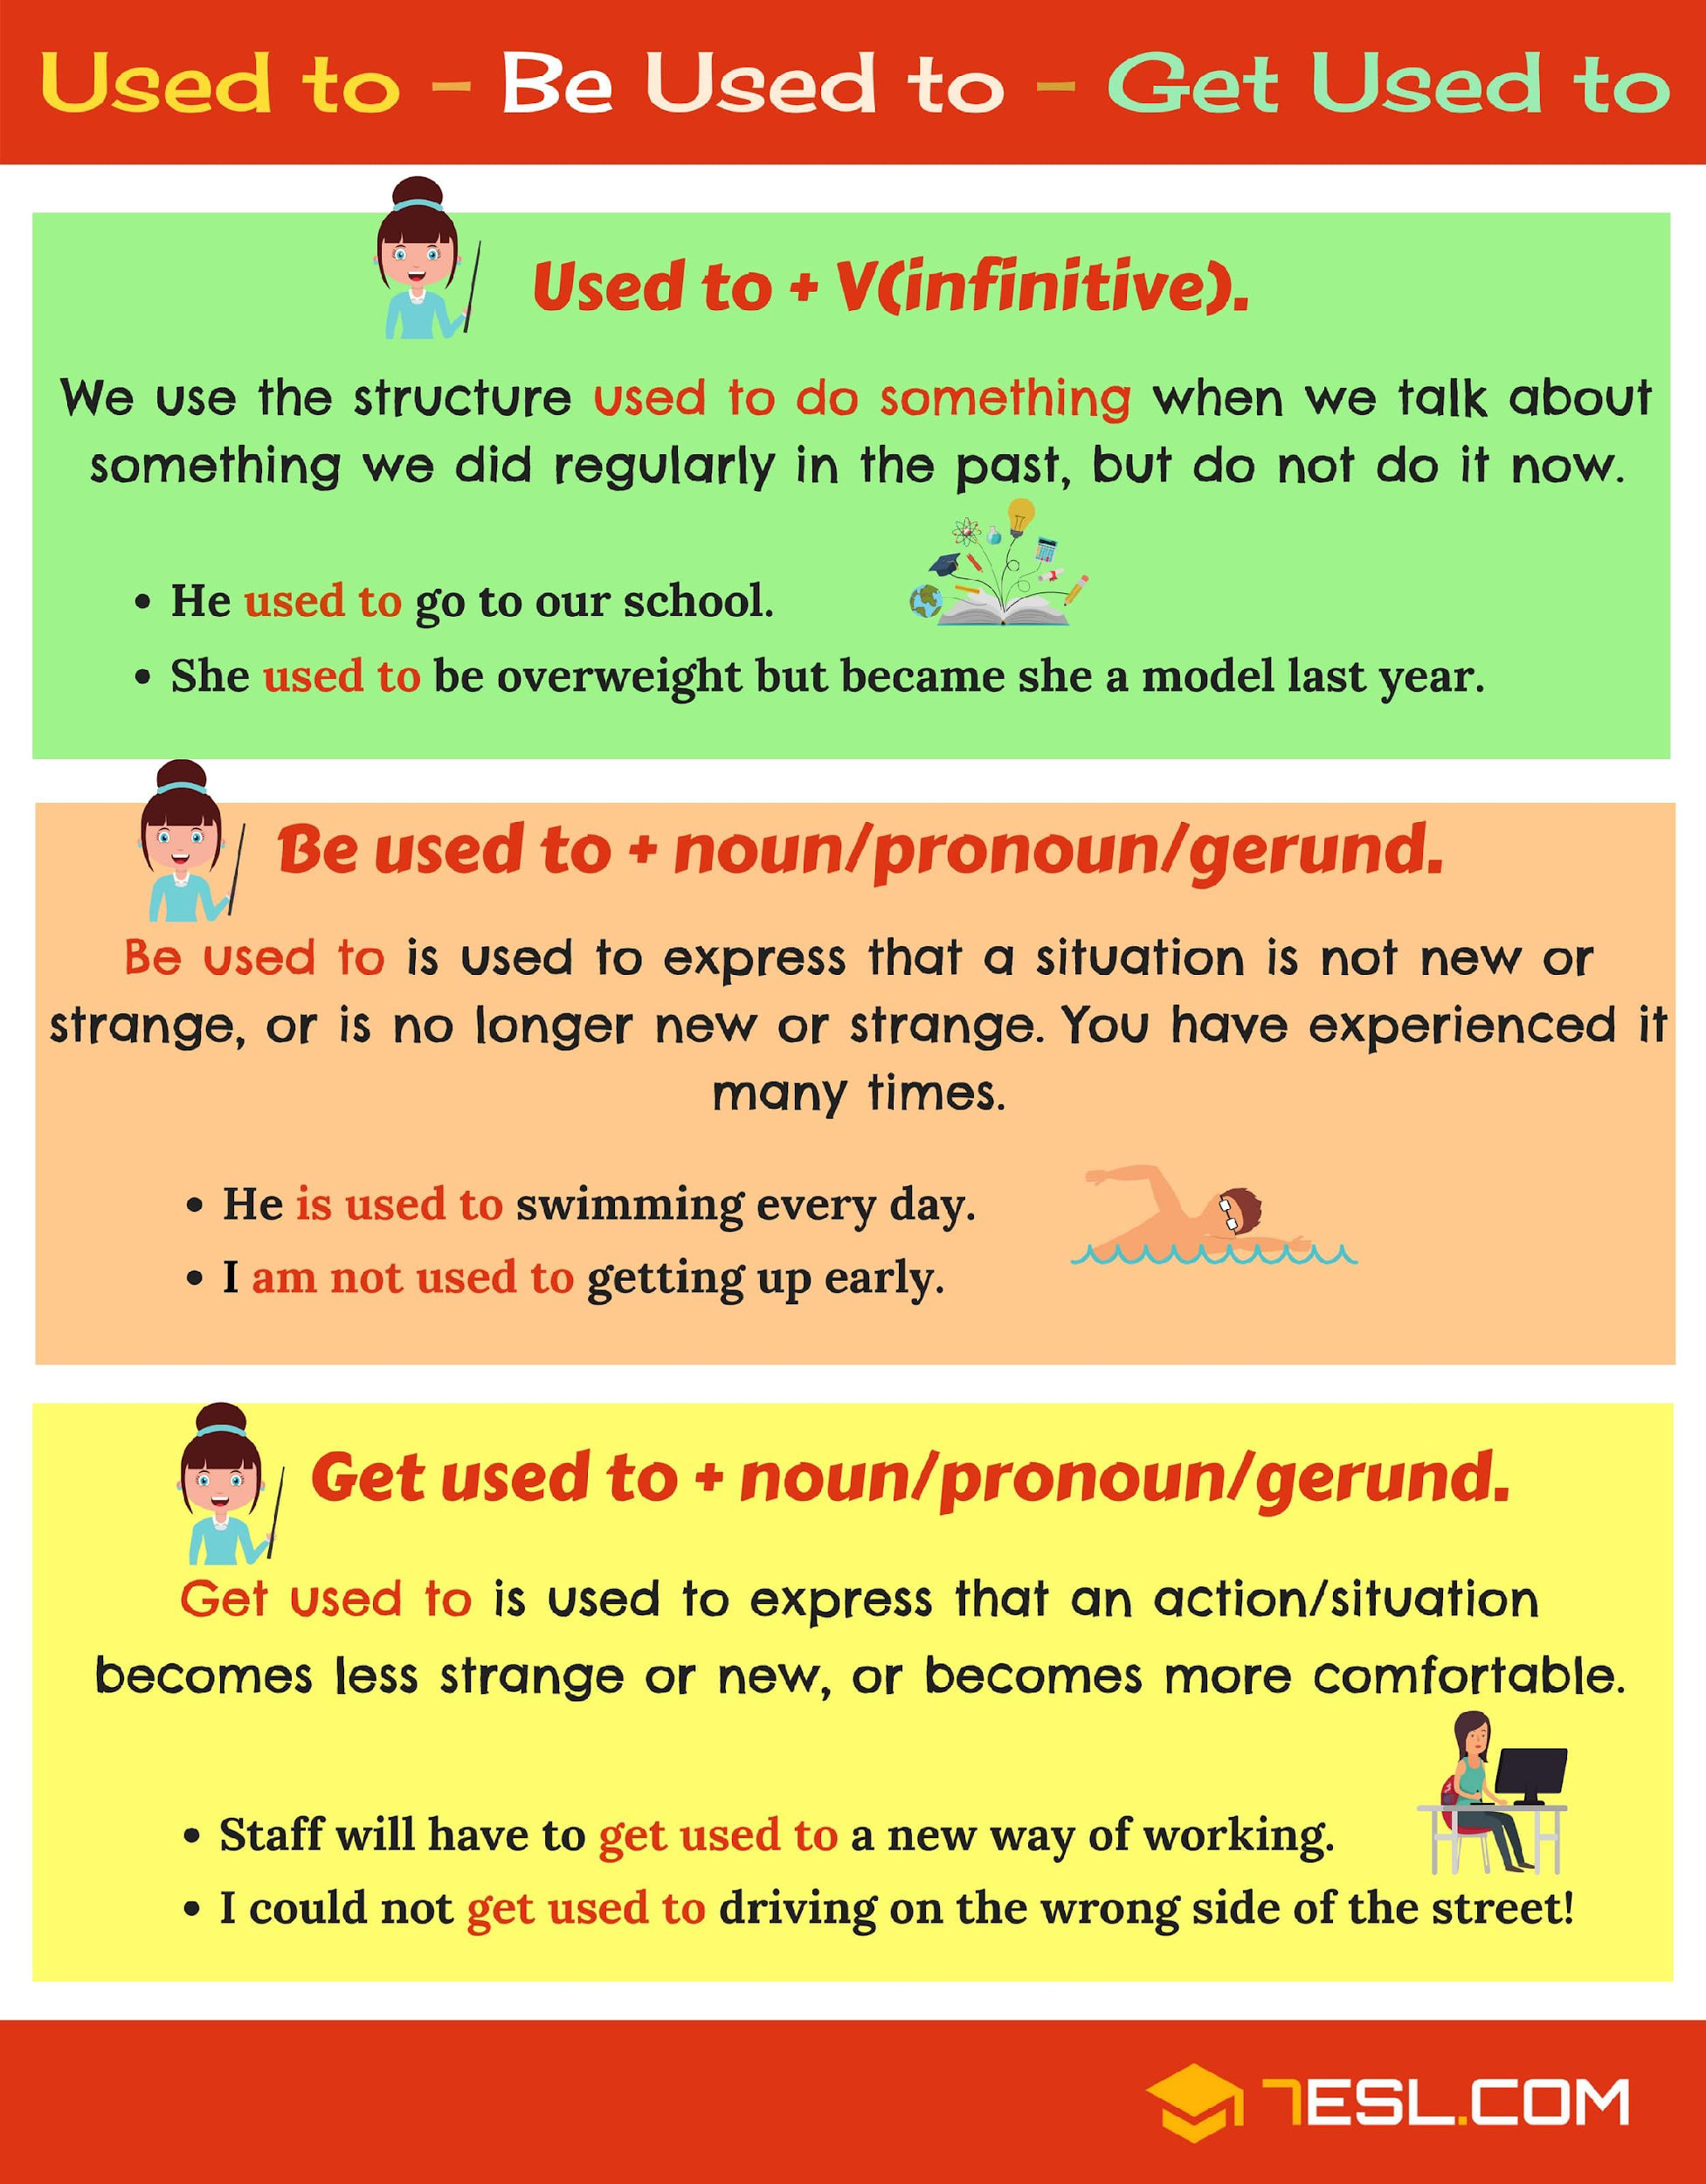

Slide 5
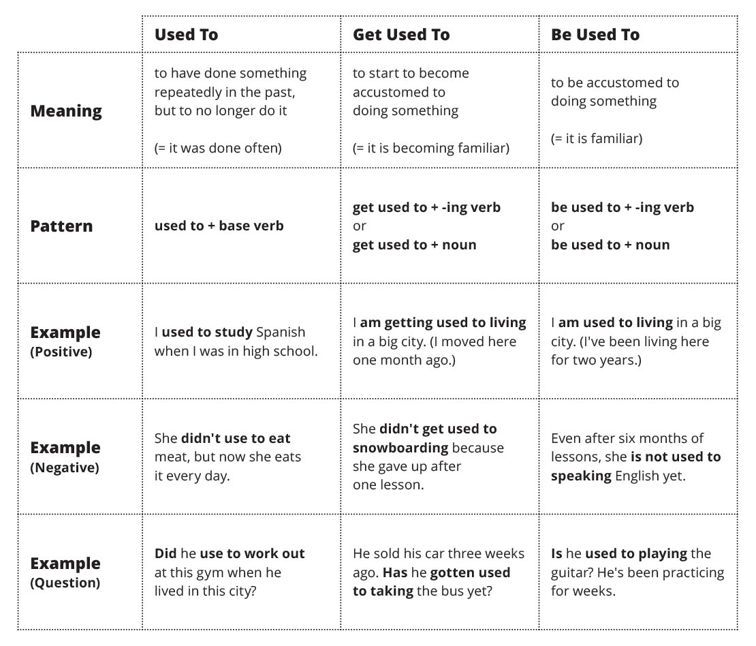
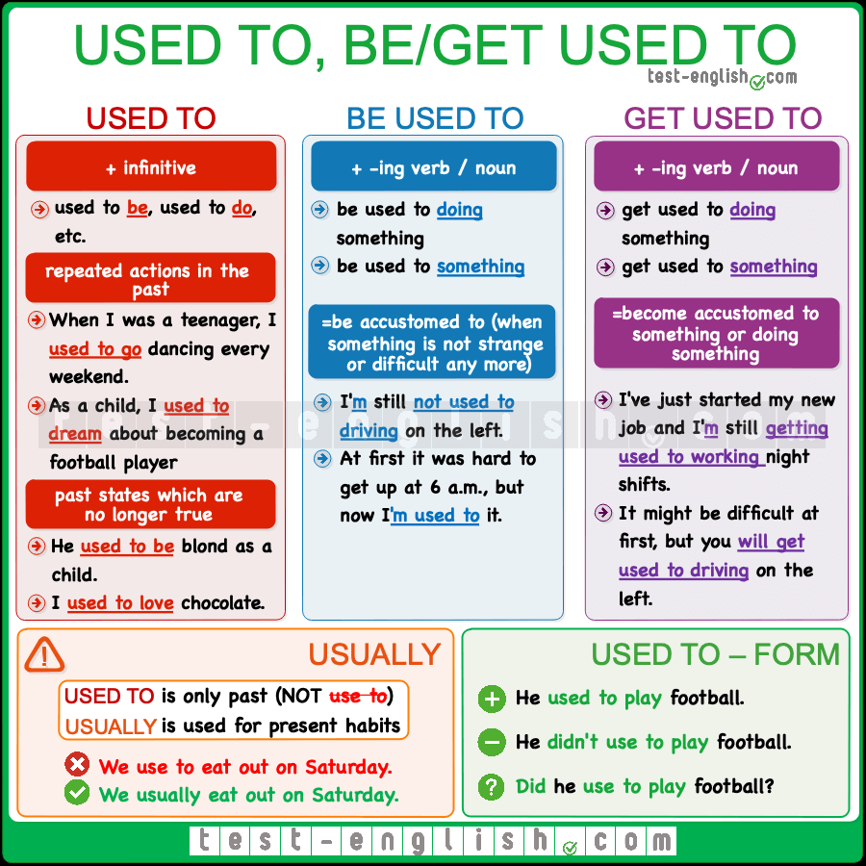


Slide 6


Slide 7
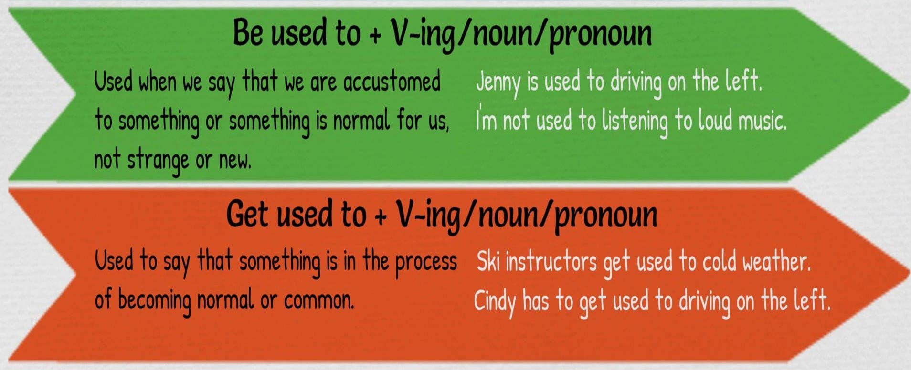

Slide 10

Videos you have to watch to Reinforce
https://www.youtube.com/watch?v=A_Rpkqz6apo (English and Spanish explanation)
https://www.youtube.com/watch?v=4YVANYGrwBw (English explanation only, very detailed and many examples)
https://www.youtube.com/watch?v=JNjhav6TaB0 (“Amigos Ingleses” explanation,really well explained English and Spanish with clear examples)
https://www.youtube.com/watch?v=PNEY7oWFD9Q

